Slide 1
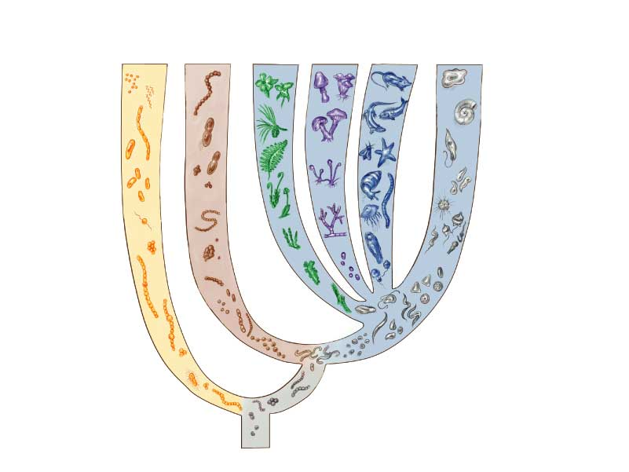
Prokaryotes
DOMAIN EUKARYA
DOMAIN
BACTERIA
DOMAIN
ARCHAEA
Kingdom
Plantae
Kingdom
Fungi
Kingdom
Animalia
Kingdom
Protista
flowering
plants
amoebae
gram-
positive
evergreens
vertebrates
foraminifera
mushrooms
purple
bacteria
ferns
methane-
producers
flagellates
salt-lovers
mosses
sponges
yeast
dinoflagellates
hot acid-lovers
choanoflagellates
cyanobacteria
diatoms
Viruses are non-living
green algae
flavobacteria
The Tree of Life
universal ancestor

